Slide 1
Git Workflow
Olivier Liechti & Simon Oulevay
COMEM Web Services 2016

Slide 2

What is Git?
Git is a free and open source distributed version control system designed to handle everything from small to very large projects with speed and efficiency.

Slide 3
Git is distributed

Slide 4


GitHub Fork
One student in each group will fork the project repository (once per group).
SoftEng repo (GitHub)
Student repo (GitHub)
This will create a copy of the repo in the GitHub account of the student who made the fork.

Slide 5
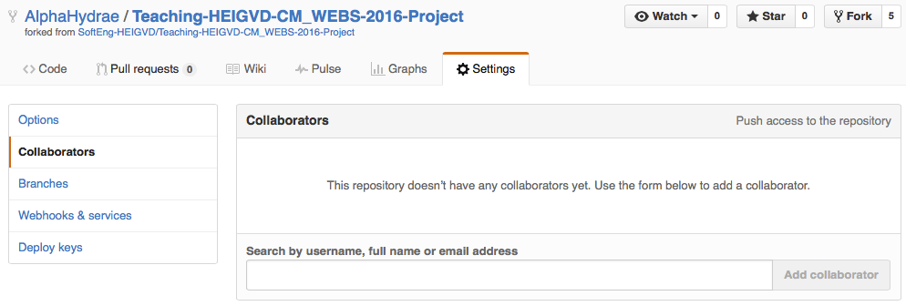

GitHub Collaborators
The student who performed the fork should go in the repository settings and add the other group members as collaborators so that they may have push access.

Slide 6
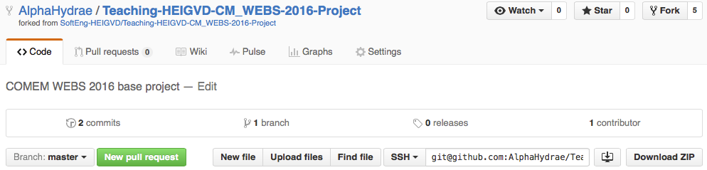

Git Clone
All team members should clone the forked repository (not the original SoftEng repository).
git clone git@github.com:StudentAccount/Teaching-HEIGVD-CM_WEBS-2016-Project.git

Slide 7
Git Repositories
SoftEng repo (GitHub)
Student repo (GitHub)
Clone
Clone
Student A repo (local)
Student B repo (local)

Slide 8
Set up the project
Put your Express application at the root of the repository (not in a subfolder).
Either regenerate one with yo express or copy the files from the example project (including invisible dot files).
After cloning or pulling the generated application, remember to run npm install to install the dependencies, which are not committed.

